Slide 1

BAPUJI INSTITUTE OF ENGINEERING AND TECHNOLOGY
DAVANAGERE, KARNATAKA-577004
DEPARTMENT OF
COMPUTER SCIENCE AND ENGINEERING
COMPUTER NETWOK
(21CS52)
Project Presentation
on
AUTOMATIC ROOM LIGHT CONTROLLER
by
Anushree Kuppast
Komal P Jadimath
USN: 4BD21CS020
4BD21CS062
Faculty
Dr. Santosh K C
Associate Professor
Department of CS&E
1

Slide 2


Abstract
In this project, we will see the Automatic Room Lights using Arduino and PIR Sensor, where the lights in the room will automatically turn ON and OFF by detecting the presence of a human. Such Automatic Room Lights can be implemented in your garages, staircases, bathrooms, etc. where we do not need continuous light but only when we are present. Also, with the help of an automatic room light control system, you need not worry about electricity as the lights get automatically off when there is no person.

Slide 3


INTRODUCTION
Initially when there is no one in the room the lights will be ON , and there will be unwanted energy consumption , so to reduce the unwanted energy consumption we are proposing a project.
Automatic room light controller using IR sensor is an innovative and energy-efficient system that uses infrared light to detect the presence of a person in a room

Slide 4

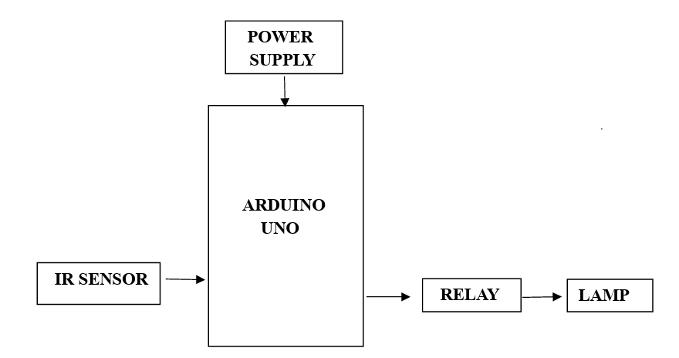

BLOCK DIAGRAM

Slide 5
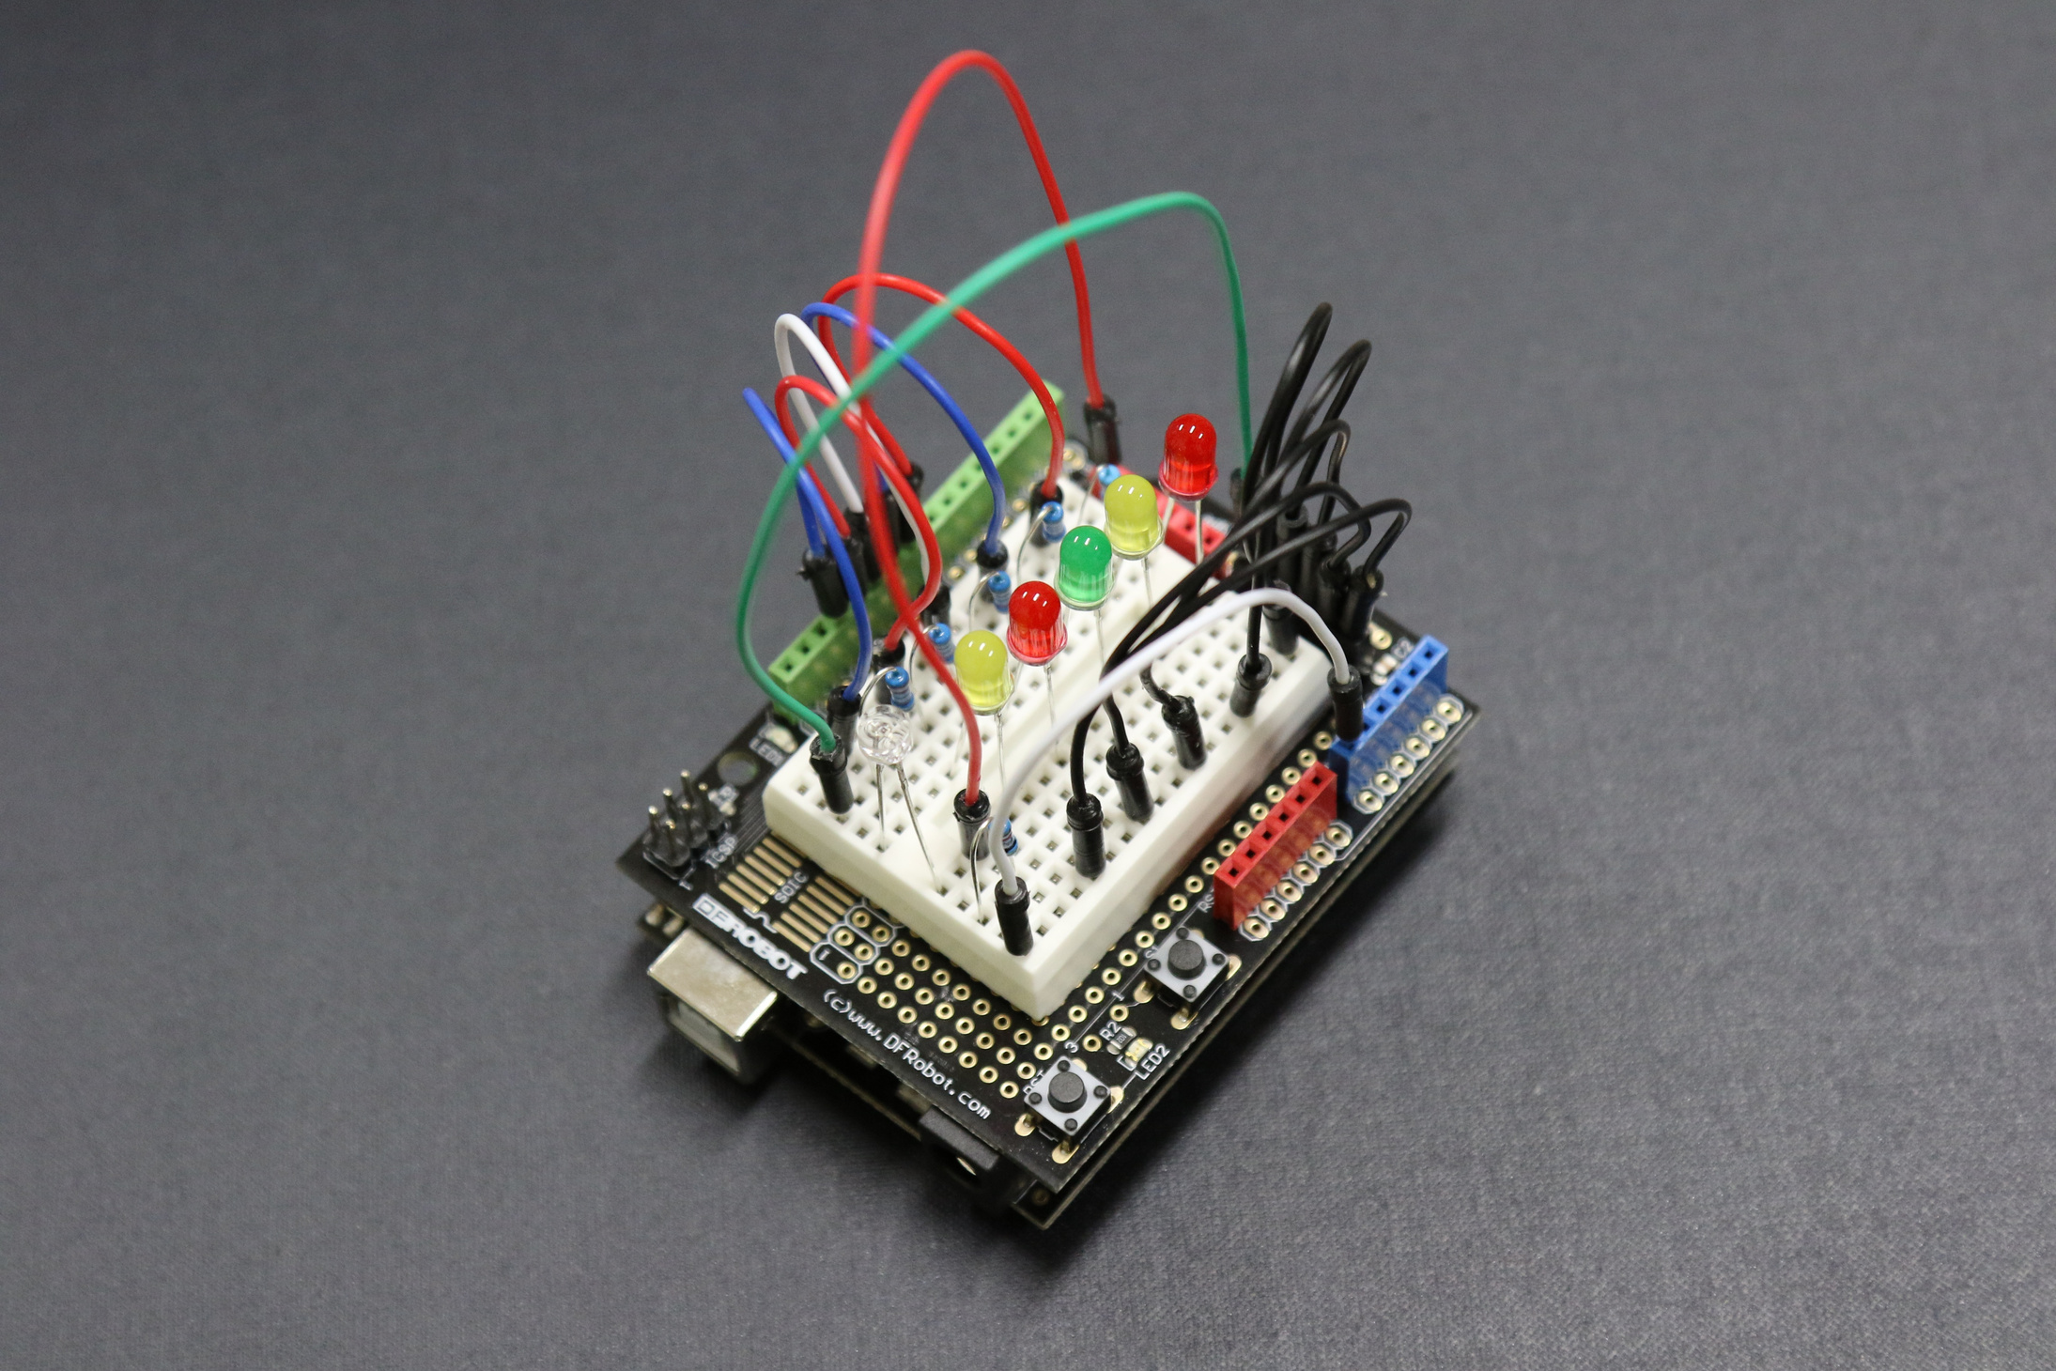
HARDWARE DESCRIPTION
Components
1. Arduino Uno Board
2. Single Channel Relay
3. IR sensor
4. Bread board
5. Connecting Wires

Slide 6
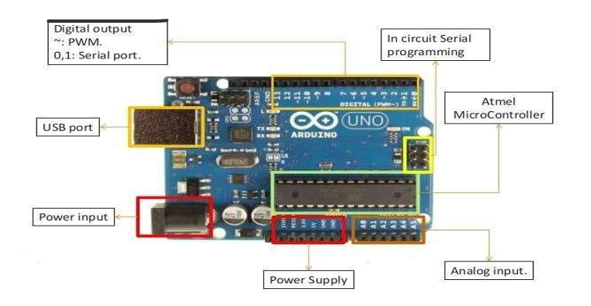
ARDUINO UNO BOARD
The Arduino UNO is an open-source microcontroller board based on the MicrochipATmega328Pmicrocontroller and developed by Arduino.cc.
The board is equipped with sets of digital and analog input/output (I/O) pins that may be interfaced to various expansion boards (shields) and other circuits.
The board has 14 Digital pins, 6 Analog pins, and programmable with the Arduino IDE (Integrated Development Environment) via a type B USB cable.

Slide 7
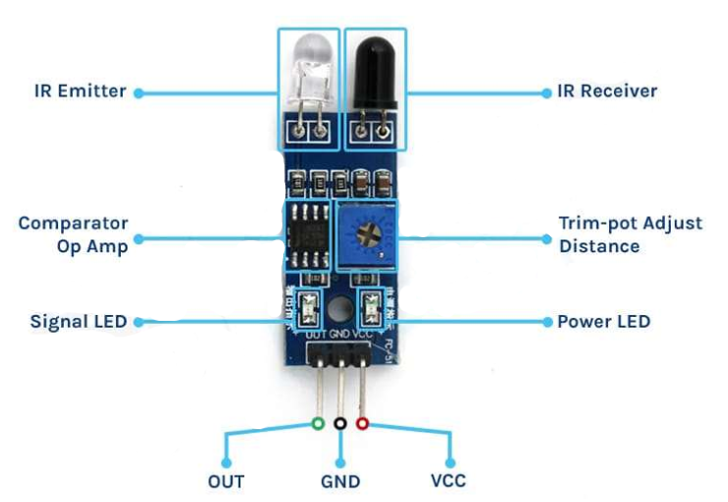
IR SENSOR
An IR sensor is an electronic device that emits light in order to sense some objects in the surroundings.
It can measure the heat of an object as well as detect motion.
In the infrared spectrum, all objects radiate some form of thermal radiation which is invisible to our eyes, but an IR sensor can detect these radiations.
IR sensors are widely used in motion detectors, which are used in building services to switch on lamps or in alarm systems to detect unwelcome guests

Slide 8
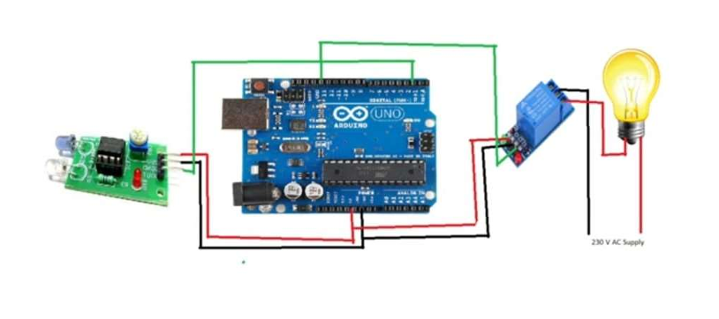
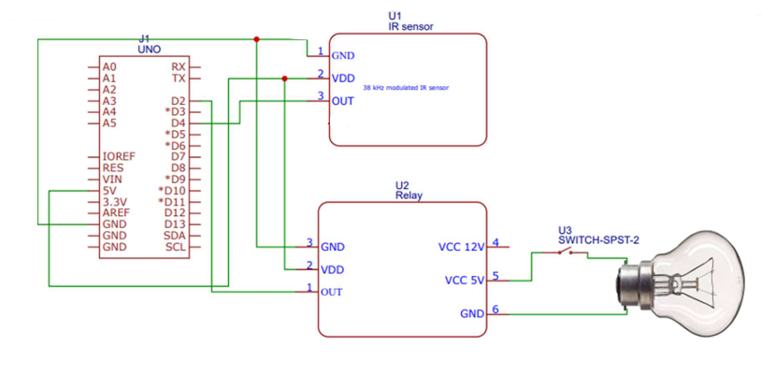
Circuit Diagram
Schematic Diagram

Slide 9

SOFTWARE REQUIRMENT
Arduino IDE
The Arduino software is an open-source integrated development environment(IDE) used to write and upload programs to Arduino boards.
The Arduino software includes a text editor for writing code, a compiler for converting the code into machine language, and a serial monitor for uploading the code to the Arduino board and viewing output.
The Arduino software is a powerful tool for anyone interested in learning about electronics and programming.
It is easy to use and can be used to create a wide variety of projects, from simple LED blinkers to complex robots.

Slide 10
APPENDIX B - SOURCE CODE
const int IR_PIN = 4;// the Arduino pin connected to output (middle) wire of sensor
const int RELAY_PIN = 2;// the Arduino pin which is connected to control relay
void setup() { Serial.begin(9600);// setup Serial Monitor to display information Serial.println("Automatic");
Serial.println("HC-SR501 sensor with relay");
pinMode(IR_PIN, INPUT);// Define SENSOR_PIN as Input from sensor
pinMode(RELAY_PIN, OUTPUT);// Define RELAY_PIN as OUTPUT for relay }
void loop() { int motion = digitalRead(IR_PIN);// read the sensor pin and stores it in "motion" variable
// if motion is detected
if(motion == LOW){ Serial.println("Motion detected");
digitalWrite(RELAY_PIN, LOW);// Turn the relay ON delay(5000);
} else{
Serial.println("No Motion detected");
digitalWrite(RELAY_PIN,HIGH);// Turn the relay OFF }
delay(1000);

Slide 11
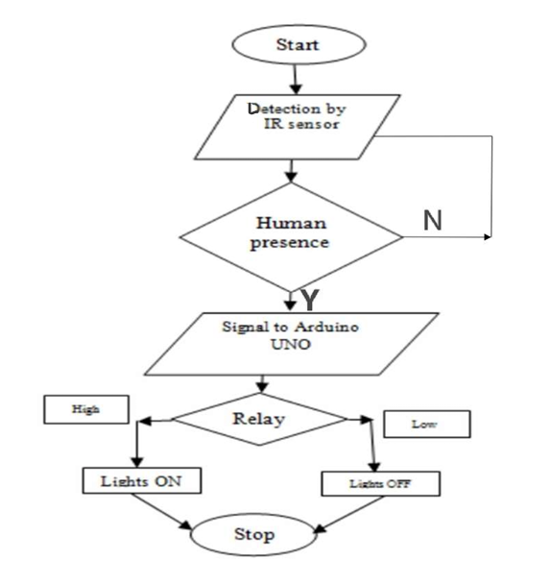

FLOWCHART
Flowcharts are visual representations of the logical flow of a program.
They use symbols and arrows to represent different program components and the sequence in which they are executed.
Flowcharts help in understanding the program's logic, identifying potential issues, and communicating the program's structure to others.

Slide 12
Conclusion
Automatic room light controllers using Arduino Uno and IR sensor can be a convenient and energy-efficient way to control lights in a room. The accuracy, sensitivity, response time, power consumption, and cost of the system can be affected by the specific components and code used. automatic room light controller using an IR sensor is a simple and effective way to save energy and improve convenience.

Slide 13


